Slide 1
DATABASE MANAGEMENT SYSTEMS
MODULE-2

Slide 2
SYLLABUS
Relational Model
Introduction to Relational Model, Concepts of Domain, Attribute, Tuple, Relation, Importance of null values
Constraints (Domain, Key Constraints, Integrity Constraints) and their importance
Relational Algebra
Relational Calculus

Slide 3
SYLLABUS
BASIC SQL
Simple Database Schema
Data Types
Table definitions (create, alter)
Different DML operations (insert, delete, update)

Slide 4
RELATIONAL MODEL

Slide 5
INTRODUCTION TO RELATIONAL MODEL
The relational model is very simple and elegant.
A database is a collection of one or more relations, where each relation is a table with rows and columns.
This simple tabular representation enables even novice users to understand the contents of a database, and it permits the use of simple, high-level languages to query the data.
The major advantages of the relational model over the older data models are its simple data representation and the ease with which even complex queries can be expressed.

Slide 6
INTRODUCTION TO RELATIONAL MODEL
The main construct for representing data in the relational model is a relation.
A relation consists of a relation schema and a relation instance.
The relation instance is a table, and the relation schema describes the column heads for the table.
The schema specifies the relation's name, the name of each field (or column, or attribute), and the domain of each field.

Slide 7
INTRODUCTION TO RELATIONAL MODEL
A domain is referred to in a relation schema by the domain name and has a set of associated values.
Example: Student Information in a University database
Relation Name?
Attributes?
Domain?

Slide 8
INTRODUCTION TO RELATIONAL MODEL
An instance of a relation is a set of tuples, also called records, in which each tuple has the same number of fields as the relation schema.
A relation instance can be thought of as a table in which each tuple is a row, and all rows have the same number of fields.
An instance of the Students relation appears in Figure.

Slide 9
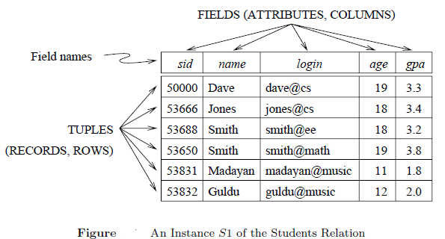

Slide 10
INTRODUCTION TO RELATIONAL MODEL
The instance S1 contains six tuples and has, as we expect from the schema, five fields.
Note that no two rows are identical. This is a requirement of the relational model. Each relation is defined to be a set of unique tuples or rows.
The order in which the rows are listed is not important.

Slide 11
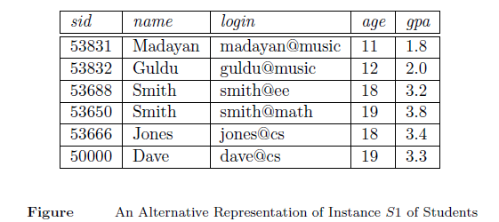

Slide 12
INTRODUCTION TO RELATIONAL MODEL
If the fields are named, as in instances, the order of fields does not matter either.
However, an alternative convention is to list fields in a specific order and to refer to a field by its position.
Thus, sid is field 1 of Students, login is field 3, and so on. If this convention is used, the order of fields is significant.

Slide 13
INTRODUCTION TO RELATIONAL MODEL
The degree, also called arity, of a relation is the number of fields.
The cardinality of a relation instance is the number of tuples in it.
In Figure, the degree of the relation (the number of columns) is five, and the cardinality of this instance is six.

Slide 14
IMPORTANCE OF NULL VALUES
Null values play a crucial role in database management by representing the absence of data in a particular field.
A null value is a special marker used in databases to indicate that a data field is empty or missing.
In other words, a null value signifies the lack of a value or the unknown value.

Slide 15
IMPORTANCE OF NULL VALUES
One of the key uses of null values in database management is to allow flexibility in data entry.
By allowing fields to be left empty or contain null values, databases can accommodate different levels of data completeness.
For example, a customer database may have fields for a customer’s phone number or email address, but not all customers may provide this information. In such cases, using null values allows for capturing only the information that is available without forcing the entry of unnecessary or irrelevant data.

Slide 16
IMPORTANCE OF NULL VALUES
Another important role of null values in database management is to distinguish between a true value and the absence of a value.
Without null values, it would be challenging to differentiate between a valid data entry of, for example, “0” and an empty data field.

Slide 17
IMPORTANCE OF NULL VALUES
In conclusion, null values are an essential component of effective database management.
They provide flexibility in data entry, help differentiate between the absence of a value and a valid value, and contribute to maintaining data integrity and consistency.

Slide 18
CONSTRAINTS
Constraints in DBMS are rules or conditions that are applied to the data within a database.
They define limitations and requirements that the data must meet, thereby preventing the entry of invalid or inconsistent data.
The purpose of constraints is to enforce data quality and prevent data inconsistencies, thereby enhancing the overall data integrity and reliability of the database.

Slide 19
CONSTRAINTS
Types of Integrity Constraints
In relational databases, there are different types of integrity constraints. They are as follows:
Domain Constraints
Key Constraints
Entity Integrity Constraints
Referential Integrity Constraints

Slide 20
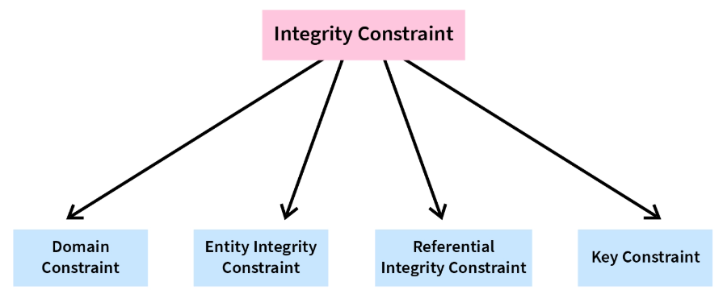
CONSTRAINTS
Types of Integrity Constraints

Slide 21
DOMAIN CONSTRAINTS
A relation schema specifies the domain of each field or column in the relation instance.
These domain constraints in the schema specify an important condition that we want each instance of the relation to satisfy:
The values that appear in a column must be drawn from the
domain associated with that column.
Thus, the domain of a field is essentially the type of that field, in programming language terms, and restricts the values that can appear in the field.

Slide 22
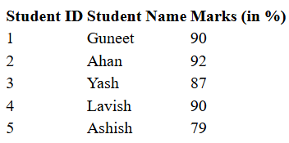
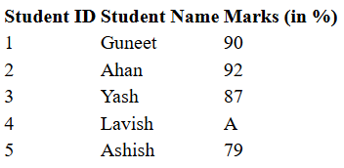

Slide 23
DOMAIN CONSTRAINTS
TYPES OF DOMAIN CONSTRAINTS
Not Null
The values that are not assigned or are unknown can be kept null.
These can be the default values for an attribute if the answer is not known.
For instance, in the above table, if we don't know the marks of the student with student id = 1, we can keep null in the marks attribute. However, certain attributes cannot be null. For instance, the Student ID is a must-known value and it can never be null as we can identify each student uniquely only with the help of Student ID.

Slide 24

DOMAIN CONSTRAINTS
TYPES OF DOMAIN CONSTRAINTS
Not Null
So, we can apply a “not null” constraint on the Student ID attribute in the above table.

Slide 25
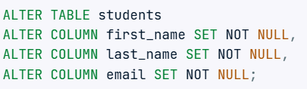
DOMAIN CONSTRAINTS
Not Null after Table Creation

Slide 26
DOMAIN CONSTRAINTS
TYPES OF DOMAIN CONSTRAINTS
CHECK
This constraint is used for specifying range of values for a particular column of a table.
When this constraint is being set on a column, it ensures that the specified column must have the value falling in the specified range.

Slide 27
DOMAIN CONSTRAINTS
TYPES OF DOMAIN CONSTRAINTS
Check
Let us say we have a class of students. Now, the school decides that only the students with marks greater than 35% will be declared qualified in the current class.
Also, they decide that only the results of those students will be entered in the table who have passed the class.
So, they want to check whether the marks of a student are greater than 35% or not. If not, that student’s data will not be entered in the table.

Slide 28

DOMAIN CONSTRAINTS
TYPES OF DOMAIN CONSTRAINTS
Check
So, for this kind of constraint application, the Domain Constraint – Check is used.

Slide 29
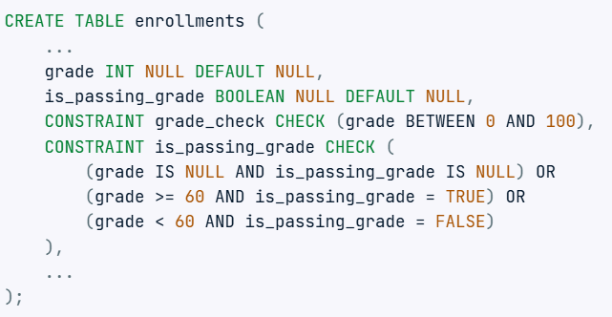
DOMAIN CONSTRAINTS
Check

Slide 30

DOMAIN CONSTRAINTS
Check

Slide 31
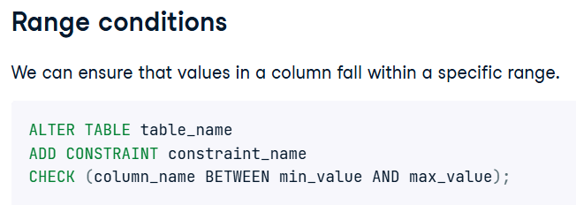
DOMAIN CONSTRAINTS
Check

Slide 32
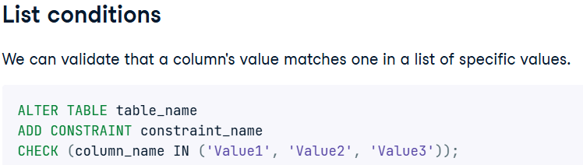
DOMAIN CONSTRAINTS
Check

Slide 33
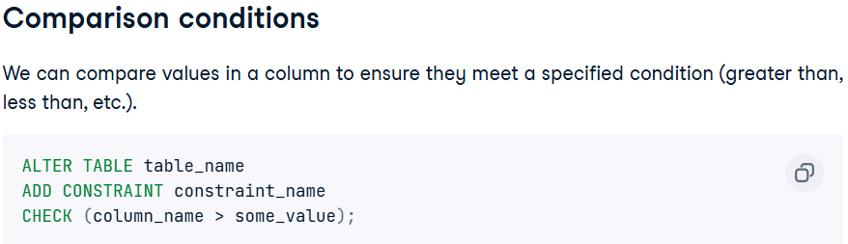
DOMAIN CONSTRAINTS
Check

Slide 34
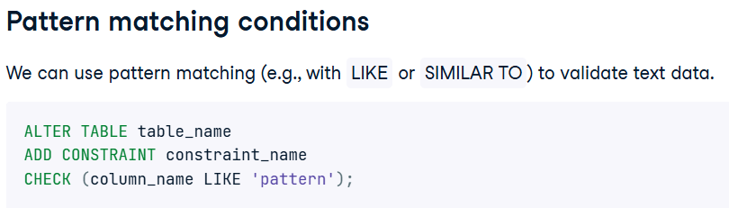
DOMAIN CONSTRAINTS
Check

Slide 35
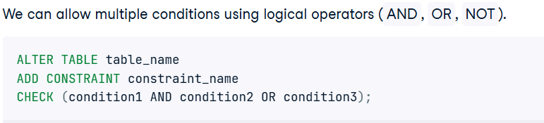
DOMAIN CONSTRAINTS
Check

Slide 36
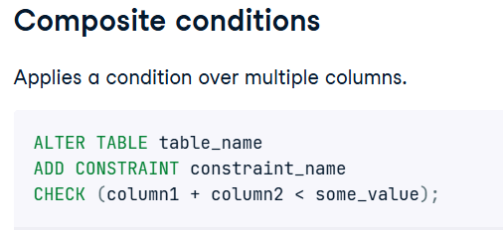
DOMAIN CONSTRAINTS
Check

Slide 37
DOMAIN CONSTRAINTS
TYPES OF DOMAIN CONSTRAINTS
UNIQUE
UNIQUE Constraint enforces a column or set of columns to have unique values.
If a column has a unique constraint, it means that particular column cannot have duplicate values in a table.

Slide 38
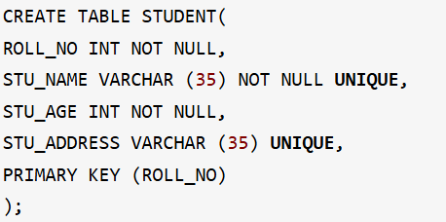

DOMAIN CONSTRAINTS
UNIQUE

Slide 39
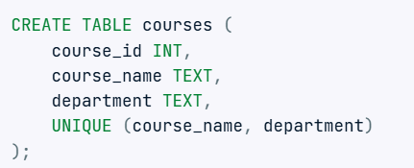

DOMAIN CONSTRAINTS
UNIQUE ON MULTIPLE ATTRIBUTES

Slide 40
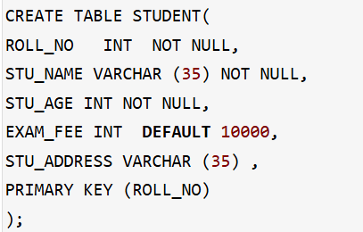
DOMAIN CONSTRAINTS
TYPES OF DOMAIN CONSTRAINTS
DEFAULT
The DEFAULT constraint provides a default value to a column when there is no value provided while inserting a record into a table.

Slide 41
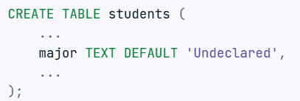

DOMAIN CONSTRAINTS
DEFAULT

Slide 42
KEY
Keys in DBMS are introduced to avoid redundancy in data. Keys help to identify the records efficiently.
Keys in DBMS can be single or a group of attributes that uniquely identify the records.
We also use keys to set up relations amongst various columns and tables of a relational database.
Keys also establish relationships between different tables, allowing for efficient querying and management of data.

Slide 43
KEY
TYPES OF KEYS
Super Key
Candidate Key
Primary Key
Alternate Key
Foreign Key
Composite Key
Unique Key

Slide 44
KEY
Super Key – A super key is a group of single or multiple keys which identifies rows in a table.
Candidate Key – is a minimal set of attributes that uniquely identify tuples in a table. Candidate Key is a super key with no repeated attributes.
Primary Key – is a column or group of columns in a table that uniquely identify every row in that table.

Slide 45
KEY
Alternate Key – is a column or group of columns in a table that uniquely identify every row in that table.
Foreign Key – is a column that creates a relationship between two tables. The purpose of Foreign keys is to maintain data integrity and allow navigation between two different instances of an entity.
Composite Key – A primary key comprising of multiple attributes and not just a single attribute is called as a composite key.

Slide 46
KEY
Unique Key – Unique key is a key with the following properties-
It is unique for all the records of the table.
Once assigned, its value can not be changed i.e. it is non-updatable.
It may have a NULL value.

Slide 47
KEY CONSTRAINTS
A key constraint is a statement that a certain minimal subset of the fields of a relation is a unique identifier for a tuple.
Types of Key Constraints
PRIMARY KEY
FOREIGN KEY

Slide 48
KEY CONSTRAINTS
PRIMARY KEY
Primary key uniquely identifies each record in a table.
It must have unique values and cannot contain nulls.
In the below example the ROLL_NO field is marked as primary key, that means the ROLL_NO field cannot have duplicate and null values.

Slide 49
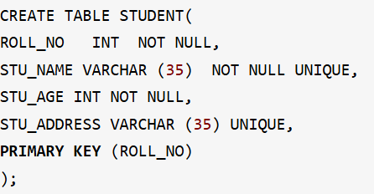
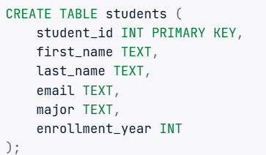
KEY CONSTRAINTS
PRIMARY KEY

Slide 50
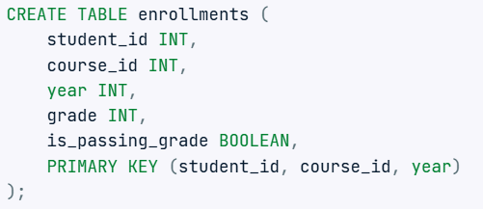
KEY CONSTRAINTS
PRIMARY KEY ON MULTIPLE ATTRIBUTES

Slide 51

KEY CONSTRAINTS
PRIMARY KEY AFTER TABLE CREATION

Slide 52
KEY CONSTRAINTS
FOREIGN KEY
Foreign Key is a field in a table which uniquely identifies each row of another table.
That is, this field points to primary key of another table. This usually creates a kind of link between the tables.

Slide 53
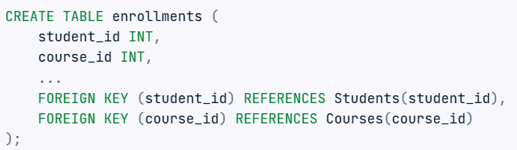
KEY CONSTRAINTS
FOREIGN KEY

Slide 54
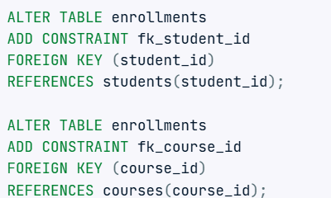
KEY CONSTRAINTS
FOREIGN KEY

Slide 55
ENTITY INTEGRITY CONSTRAINTS
Entity Integrity Constraints states that the primary value key cannot be null because the primary value key is used to find out individual rows in relation and if the value of the primary key is null then it is not easy to identify those rows.
There can be a null value in the table apart from the primary key field.

Slide 56
REFERENTIAL INTEGRITY CONSTRAINTS
Referential Integrity Constraint is specific between two tables.
In case of referential integrity constraints, if a Foreign key in Table 1 refers to Primary key of Table 2 then every value of the Foreign key in Table 1 must be null or available in Table 2.

Slide 57
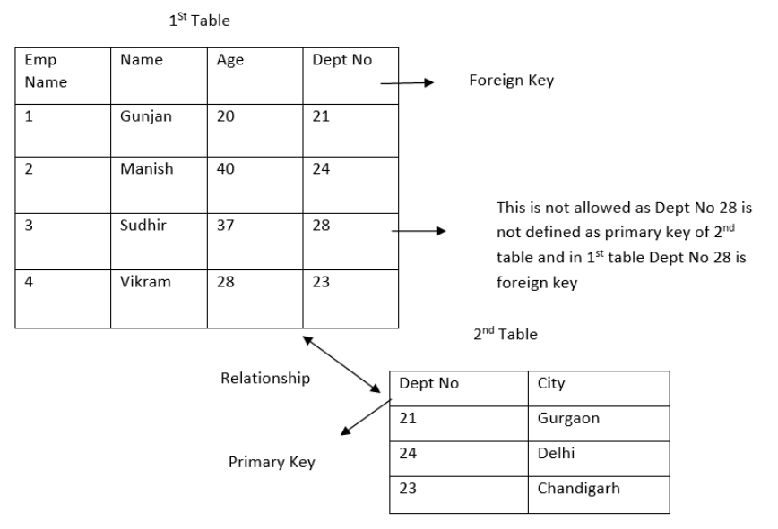

Slide 58
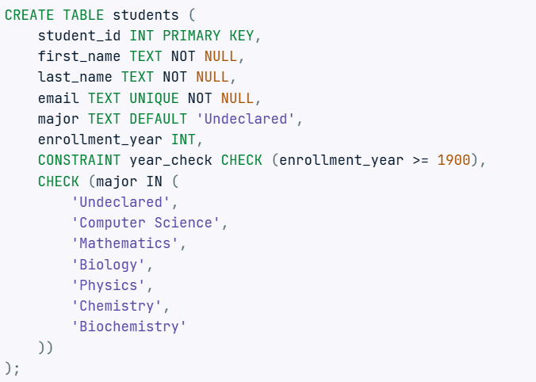

Slide 59
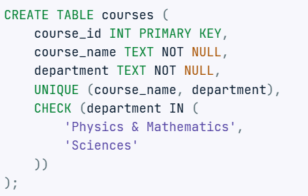

Slide 60
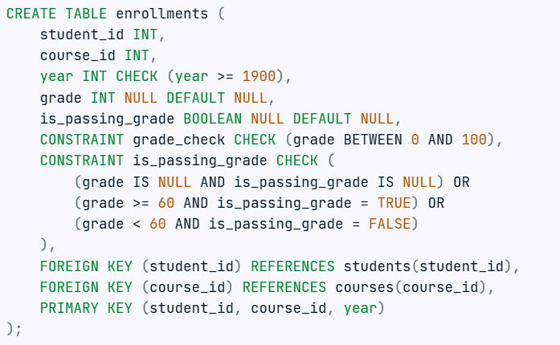

Slide 61
RELATIONAL ALGEBRA
Relational algebra is one of the two formal query languages associated with the relational model.
Queries in relational algebra are composed using a collection of operators, and each query describes a step-by-step procedure for computing the desired answer.
In defining relational algebra and calculus, the alternative of referring to fields by position is more convenient than referring to fields by name.

Slide 62
RELATIONAL ALGEBRA
A fundamental property is that every operator in the algebra accepts (one or two) relation instances as arguments and returns a relation instance as the result.
A relational algebra expression is recursively defined to be a relation, a unary algebra operator applied to a single expression, or a binary algebra operator applied to two expressions.
This property makes it easy to compose operators to form a complex query.

Slide 63
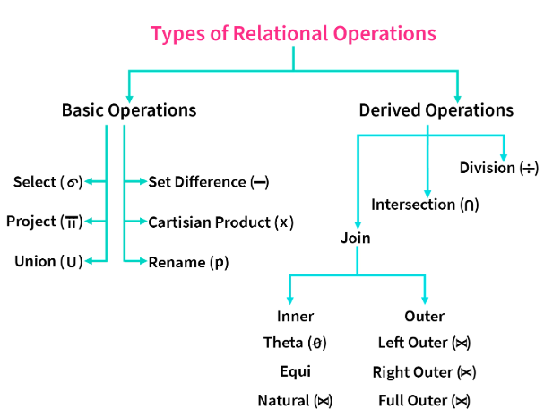

Slide 64

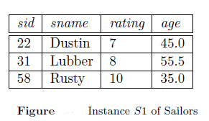
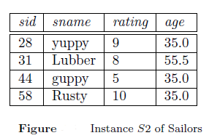
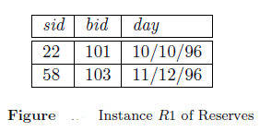
RELATIONAL ALGEBRA

Slide 65
RELATIONAL ALGEBRA
SELECTION
Relational algebra includes operator to select rows from a relation (σ).
These operations allow us to manipulate data in a single relation.
Consider the instance of the Sailors relation shown denoted as S2.

Slide 66
RELATIONAL ALGEBRA
SELECTION
We can retrieve rows corresponding to expert sailors by using the operator σ .
The expression evaluates to the relation.
The subscript rating>8 specifies the selection criterion to be applied while retrieving tuples.

Slide 67
RELATIONAL ALGEBRA
SELECTION
The selection operator σ specifies the tuples to retain through a selection condition.
In general, the selection condition is a Boolean combination of terms that have the form
attribute op constant
or
attribute1 op attribute2,
where op is one of the comparison operators.

Slide 68
RELATIONAL ALGEBRA
PROJECTION
Relational algebra includes operator to project columns (𝞹).
The projection operator 𝞹 allows us to extract columns from a relation;
For example, we can find out all sailor names and ratings by using 𝞹.
The expression evaluates to the relation S2.

Slide 69
RELATIONAL ALGEBRA
SELECTION AND PROJECTION
Since the result of a relational algebra expression is always a relation, we can substitute an expression wherever a relation is expected.
For example, we can compute the names and ratings of highly rated sailors by combining two of the preceding queries.
The expression

Slide 70
RELATIONAL ALGEBRA
SET OPERATIONS
The following standard operations on sets are also available in relational algebra:
Union (∪ )
Intersection (∩)
Set difference (−)
Cross-product or Cartesian Product ( x ).

Slide 71
RELATIONAL ALGEBRA
UNION
R ∪ S returns a relation instance containing all tuples that occur in either relation instance R or relation instance S (or both).
R and S must be union compatible, and the schema of the result is defined to be identical to the schema of R.

Slide 72
RELATIONAL ALGEBRA
INTERSECTION
R ∩ S returns a relation instance containing all tuples that occur in both R and S.
The relations R and S must be union-compatible, and the schema of the result is defined to be identical to the schema of R.

Slide 73
RELATIONAL ALGEBRA
SET-DIFFERENCE
R−S returns a relation instance containing all tuples that occur in R but not in S.
The relations R and S must be union-compatible, and the schema of the result is defined to be identical to the schema of R.

Slide 74
RELATIONAL ALGEBRA
CROSS-PRODUCT OR CARTESIAN PRODUCT
R x S returns a relation instance whose schema contains all the fields of R (in the same order as they appear in R) followed by all the fields of S (in the same order as they appear in S).
The result of R x S contains one tuple <r , s>; the concatenation of tuples r and s for each pair of tuples r ∊ R; s ∊ S.
The cross-product operation is sometimes called Cartesian product.

Slide 75
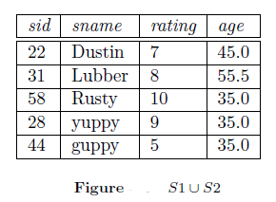
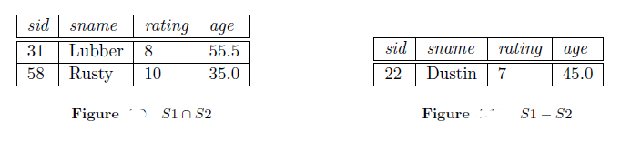

Slide 76
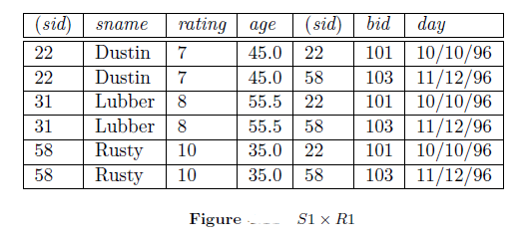

Slide 77
RELATIONAL ALGEBRA
CROSS-PRODUCT OR CARTESIAN PRODUCT
R x S returns a relation instance whose schema contains all the fields of R (in the same order as they appear in R) followed by all the fields of S (in the same order as they appear in S).
The result of R x S contains one tuple <r , s>; the concatenation of tuples r and s for each pair of tuples r ∊ R; s ∊ S.
The cross-product operation is sometimes called Cartesian product.

Slide 78
BASIC SQL

Slide 79
SYLLABUS
BASIC SQL
Simple Database Schema
Data Types
Table definitions (create, alter)
Different DML operations (insert, delete, update)

Slide 80
BASIC SQL
Structured Query Language (SQL) is the most widely used commercial relational database language.
IBM developed the original version of SQL, originally called Sequel, as part of the System R project in the early 1970s.
The Sequel language has evolved since then, and its name has changed to SQL (Structured Query Language).

Slide 81
BASIC SQL
The SQL language has several aspects to it
The Data Definition Language (DDL)
The Data Manipulation Language (DML)
Integrity
View definition
Transaction Control
Embedded SQL and Dynamic SQL
Authorization

Slide 82
BASIC SQL
DATA-DEFINITION LANGUAGE (DDL)
The SQL DDL provides commands for defining relation schemas, deleting relations, and modifying relation schemas.
DATA-MANIPULATION LANGUAGE (DML)
The SQL DML provides the ability to query information from the database and to insert tuples into, delete tuples from, and modify tuples in the database.

Slide 83
BASIC SQL
INTEGRITY
The SQL DDL includes commands for specifying integrity constraints that the data stored in the database must satisfy.
Updates that violate integrity constraints are disallowed.
VIEW DEFINITION
The SQL DDL includes commands for defining views.
TRANSACTION CONTROL
SQL includes commands for specifying the beginning and ending of transactions.

Slide 84
BASIC SQL
EMBEDDED SQL AND DYNAMIC SQL
Embedded and dynamic SQL define how SQL statements can be embedded within general-purpose programming languages, such as C, C++, and Java.
AUTHORIZATION
The SQL DDL includes commands for specifying access rights to relations and views.

Slide 85
THE FORM OF BASIC SQL QUERY
Let us see the syntax of a simple SQL query through a conceptual evaluation strategy.
A conceptual evaluation strategy is a way to evaluate the query that is intended to be easy to understand, rather than efficient.
A DBMS would typically execute a query in a different and more efficient way.

Slide 86
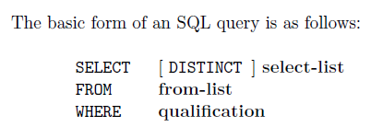
THE FORM OF BASIC SQL QUERY

Slide 87
THE FORM OF BASIC SQL QUERY
Every query must have
a SELECT clause, which specifies columns to be retained in the result, and
In cases where we want to force the elimination of duplicates, we insert the keyword distinct after select.
a FROM clause, which specifies a cross-product of tables.
the optional WHERE clause specifies selection conditions on the tables mentioned in the FROM clause.

Slide 88
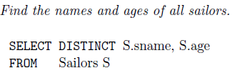
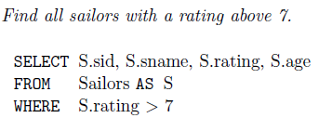
THE FORM OF BASIC SQL QUERY
Examples:

Slide 89
THE FORM OF BASIC SQL QUERY
CONCEPTUAL EVALUATION STRATEGY
Compute the cross-product of the tables in the from-list.
Delete those rows in the cross-product that fail the qualification conditions.
Delete all columns that do not appear in the select-list.
If DISTINCT is specified, eliminate duplicate rows.

Slide 90
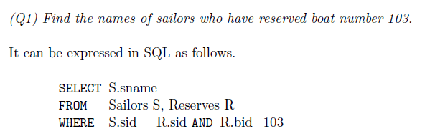
THE FORM OF BASIC SQL QUERY
Examples:

Slide 91
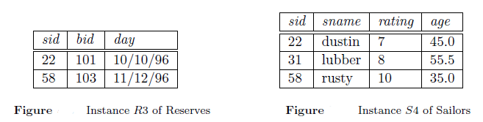
THE FORM OF BASIC SQL QUERY
Examples:

Slide 92
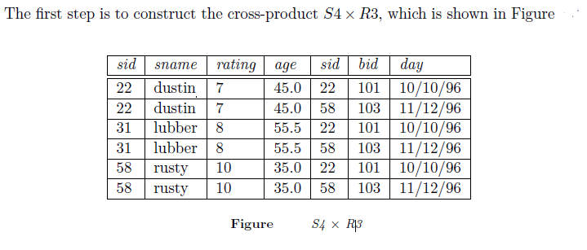
THE FORM OF BASIC SQL QUERY
Examples:

Slide 93
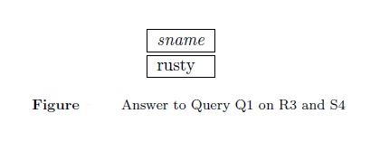
THE FORM OF BASIC SQL QUERY
Examples:

Slide 94
SIMPLE DATABASE SCHEMA
A database schema defines the structure and organization of data within a database.
It outlines how data is logically stored, including the relationships between different tables and other database objects.
The schema serves as a blueprint for how data is stored, accessed, and manipulated, ensuring consistency and integrity throughout the system.

Slide 95
SIMPLE DATABASE SCHEMA
Database systems have several schemas, partitioned according to the levels of abstraction.
The physical schema describes the database design at the physical level, while the logical schema describes the database design at the logical level.
A database may also have several schemas at the view level, sometimes called subschemas, that describe different views of the database.
Of these, the logical schema is by far the most important, in terms of its effect on application programs, since programmers construct applications by using the logical schema.

Slide 96
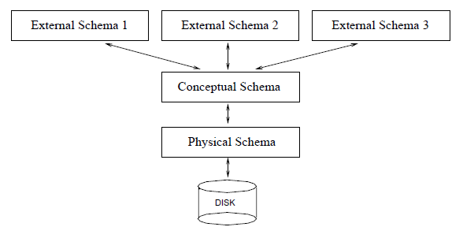
SIMPLE DATABASE SCHEMA

Slide 97
SIMPLE DATABASE SCHEMA
KEY POINTS ABOUT A DATABASE SCHEMA
It defines how data is logically organized, including tables, fields, and relationships.
It outlines the relationships between entities, such as primary and foreign keys.
It helps resolve issues with unstructured data by organizing it in a clear, structured way.
Database schemas guide how data is accessed, modified, and maintained.

Slide 98
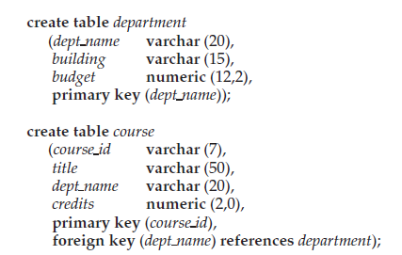
SIMPLE DATABASE SCHEMA
CREATING DATABASE SCHEMA FOR UNIVERSITY DATABASE

Slide 99
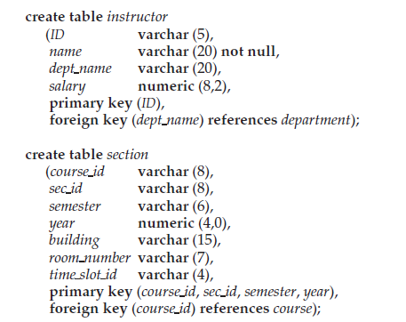
SIMPLE DATABASE SCHEMA
CREATING DATABASE SCHEMA FOR UNIVERSITY DATABASE

Slide 100
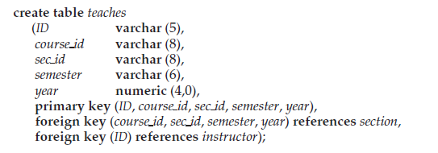
SIMPLE DATABASE SCHEMA
CREATING DATABASE SCHEMA FOR UNIVERSITY DATABASE

Slide 101
VIEWS IN RELATIONAL MODEL
Views in SQL are a type of virtual table that simplifies how users interact with data across one or more tables.
Unlike traditional tables, a view in SQL does not store data on disk; instead, it dynamically retrieves data based on a pre-defined query each time it’s accessed.
SQL views are particularly useful for managing complex queries, enhancing security, and presenting data in a simplified format.

Slide 102
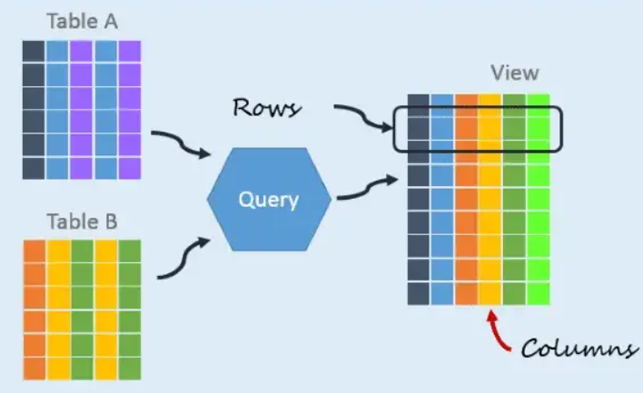
VIEWS IN RELATIONAL MODEL

Slide 103
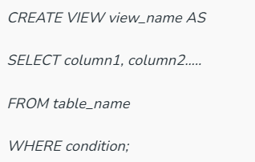
VIEWS IN RELATIONAL MODEL
CREATE VIEWS in SQL
We can create a view using CREATE VIEW statement. A View can be created from a single table or multiple tables.

Slide 104


VIEWS IN RELATIONAL MODEL
Creating View from a single table

Slide 105


VIEWS IN RELATIONAL MODEL
Creating View from multiple tables

Slide 106
VIEWS IN RELATIONAL MODEL
Deleting View

Slide 107
DATATYPES
The SQL standard supports a variety of built-in types, including:
char(n): A fixed-length character string with user-specified length n. The full form, character, can be used instead.
varchar(n): A variable-length character string with user-specified maximum length n. The full form, character varying, is equivalent.

Slide 108
DATATYPES
int: An integer (a finite subset of the integers that is machine dependent). The full form, integer, is equivalent.
smallint: A small integer (a machine-dependent subset of the integer type).
numeric(p, d): A fixed-point number with user-specified precision. The number consists of p digits (plus a sign), and d of the p digits are to the right of the decimal point.

Slide 109
DATATYPES
The char data type stores fixed length strings. Consider, for example, an attribute A of type char(10). If we store a string “Avi” in this attribute, 7 spaces are appended to the string to make it 10 characters long.
In contrast, if attribute B were of type varchar(10), and we store “Avi” in attribute B, no spaces would be added.

Slide 110
SQL DATA DEFINITION
The set of relations in a database must be specified to the system by means of a data-definition language (DDL).
The SQL DDL allows specification of not only a set of relations, but also information about each relation, including:
The schema for each relation.
The types of values associated with each attribute.
The integrity constraints.
The set of indices to be maintained for each relation.
The security and authorization information for each relation.
The physical storage structure of each relation on disk.

Slide 111
SQL DATA DEFINITION
The basic DDL commands are
CREATE
ALTER
TRUNCATE
DROP
RENAME

Slide 112
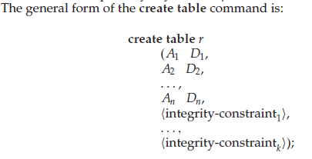
SQL DATA DEFINITION
CREATE
We define an SQL relation by using the create table command.

Slide 113
SQL DATA DEFINITION
CREATE
where r is the name of the relation, each Ai is the name of an attribute in the schema of relation r, and Di is the domain of attribute Ai; that is, Di specifies the type of attribute Ai along with optional constraints that restrict the set of allowed values for Ai . The semicolon shown at the end of the create table statements

Slide 114
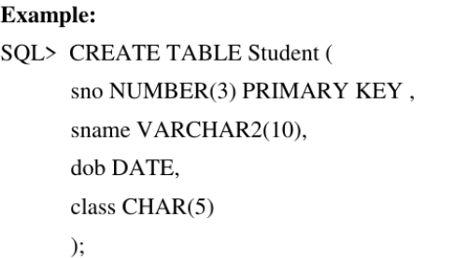
SQL DATA DEFINITION
CREATE

Slide 115
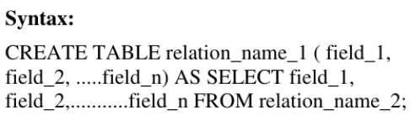
SQL DATA DEFINITION
CREATE TABLE…..AS SELECT
This is used to create the structure of a new relation from the structure of an existing relation.

Slide 116
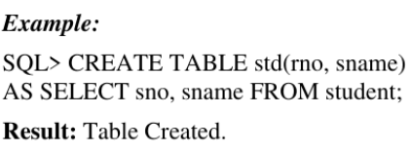
SQL DATA DEFINITION
CREATE TABLE…..AS SELECT

Slide 117

SQL DATA DEFINITION
ALTER - ALTER TABLE with ADD:
This is used to add some extra fields into existing relation.

Slide 118

SQL DATA DEFINITION
ALTER - ALTER TABLE with MODIFY:
This is used to change the width as well as data type of fields of existing relations.

Slide 119

SQL DATA DEFINITION
TRUNCATE
This command will remove the data permanently. But structure will not be removed.

Slide 120

SQL DATA DEFINITION
DROP
This is used to delete the structure of a relation. It permanently deletes the records in the table.

Slide 121
DML OPERATIONS
The Data Manipulation Language (DML) is used to retrieve, insert and modify database information.
These commands will be used by all database users during the routine operation of the database.
The DML commands in SQL modify or change the data present in the database.

Slide 122
DML OPERATIONS
Following are the four main commands in DML:
SELECT
INSERT
UPDATE
DELETE

Slide 123
DML OPERATIONS
SELECT
It is used to select and retrieve data from the database table.
Various ‘clauses’ that go with the SELECT command are WHERE, GROUP BY, HAVING, ORDER BY, AS, and DISTINCT.
These clauses help filter the results stated in the SELECT clauses.

Slide 124
DML OPERATIONS
SELECT
WHERE Clause: It specifies which row to retrieve from the database.
GROUP BY Clause: It is used to arrange data into groups so that aggregate functions can be applied.
HAVING Clause: It selects among groups defined by the Group By clause by specifying conditions.

Slide 125
DML OPERATIONS
SELECT
ORDER BY Clause: It specifies the order in which to return the rows.
AS Clause: It is used to give a column or table with a temporary name.
DISTINCT Clause: Its use is to remove duplicates from the result set of a SELECT statement (SELECT DISTINCT).

Slide 126

DML OPERATIONS
SELECT -Synatx
SELECT column1, column2, ...FROM table_name;
Full Syntax

Slide 127

DML OPERATIONS
INSERT
This is used to add records into a relation. These are three type of INSERT INTO queries.

Slide 128

DML OPERATIONS
INSERT

Slide 129

DML OPERATIONS
INSERT

Slide 130

DML OPERATIONS
UPDATE
To change existing data in a table, you use the UPDATE statement.

Slide 131

DML OPERATIONS
DELETE
It is used to delete some or all of the records from the existing table. It should contain the WHERE clause to give the condition.

Slide 132
Mobile project
Show and explain your web, app or software projects using these gadget templates.

Slide 133
2. Extra Resources
For Business Plans, Marketing Plans, Project Proposals, Lessons, etc

Slide 134
Diagrams and infographics

Slide 135

Free templates for all your presentation needs
For PowerPoint and Google Slides
100% free for personal or commercial use
Ready to use, professional and customizable
Blow your audience away with attractive visuals

